Slide 1
Learning to Suggest: A Machine Learning Framework for Ranking Query Suggestions
Date: 2013/02/18
Author: Umut Ozertem, Olivier Chapelle, Pinar Donmez, Emre Velipasaoglu
Source: SIGIR’12
Advisor: Jia-ling, Koh
Speaker: Shun-Chen, Cheng

Slide 2
Outline
Introduction
Target Generation
Suggestion Candidates
Query logs
Synthetic Suggestions
Most Frequent Extensions
Machine learning
Features
Learning
Evaluation
Conclusions

Slide 3
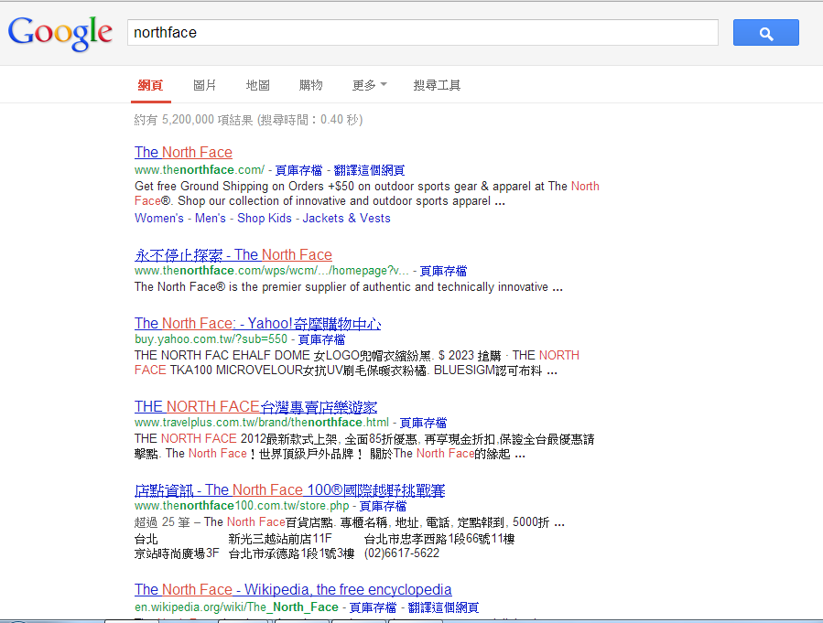
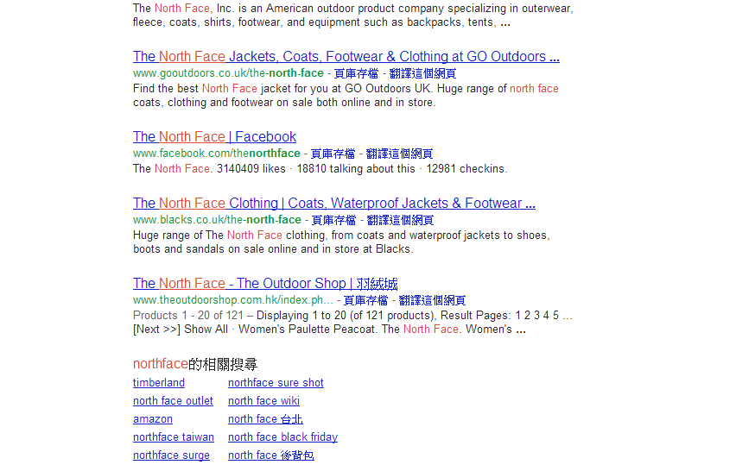
Introduction

Slide 4
Introduction
Wisdom of Crowds
Term semantic

Slide 5
The shortcomings of those methods:
the utility of a query reformulation suggestion to the user’s search task is indirectly handled
all co-occurrences in the query logs are treated equally
models that are solely based on collocated queries in the past logs
So, the goal is addressing these shortcomings.

Slide 6
Ways to address the problems:
A utility model that takes into account positions of URLs that are common to result sets of the original query and the suggestions.
An implicit task boundary method to model whether a following query is a continuation of the preceding queries
Predict the utility of suggestion by lexical and result set features.

Slide 7
Outline
Introduction
Target Generation
Suggestion Candidates
Query logs
Synthetic Suggestions
Most Frequent Extensions
Machine learning
Features
Learning
Evaluation
Conclusions

Slide 8
Target Generation
Query co-occurrence : when two queries are manually1 issued by the same user within the same session.
Session : all the user activity within a time window limited by 10 minutes of inactivity.
The targets to be used in our machine learning model depend on Pr(q2, q1) ,namely the probability of query co-occurrence.

Slide 9
Two problem with Pr(q2, q1) :
1. query q2 is unrelated to q1
2. the result page associated with query q2 may not be
useful
So,
given a query pair (q1, q2), the query q2 was a helpful reformulation of query q1 if and only if the following two conditions are satisfied:
1. The query q2 is a continuation of q1. If the query q2 is the beginning of a new task and has nothing to do with q1, we should not consider q2 to be a helpful reformulation for q1.
2. The query q2 has a positive utility, that is the search results returned for that query are useful to the user.

Slide 10
Utility of Reformulation
Reformulations followed by a click are not always useful.
For example
Although co-occurrences like these lead to a click on the result set of the second query q2, they do not likely take the user to a destination URL that is not already directly accessible from the original query q1.
bank of america
bank ofamerica online
facebook login
facebook
or

Slide 11
a reformulation to be useful only if it leads to a click on a URL that either is not existing in the search result page of q1 or that is ranked higher than that in the search result page of q1.
When there was a click on q2, the reformulation is defined to be useful if Δ > 0.
Dc : the set of clicked documents on the result page of q2
r(q2,d) : the rank of the given document d ∈ Dc for the given query q and returns +inf if the URL is not ranked.

Slide 12
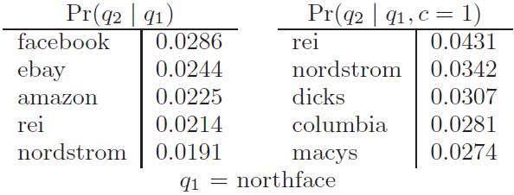
It is important that q2 is a continuation of q1

Slide 13
Implicit task boundary detection
q2 is a continuation of q1 (denoted by c = 1)
q2 is useful (denoted by u = 1)
implicitly conditioned on u = 1
But, this could lead to negative probabilities.

Slide 14
Outline
Introduction
Target Generation
Suggestion Candidates
Query logs
Synthetic Suggestions
Most Frequent Extensions
Machine learning
Features
Learning
Evaluation
Conclusions

Slide 15
Query log
for head queries in particular, we only consider the queries q2 which co-occured at least 3 times with q1.
But it may limits the coverage of query suggestions and many queries with a low query log frequency will remain with a few or no suggestions.

Slide 16
Synthetic Suggestions
The query “big lots store” does not have many good suggestions as compared to “big lots”, due to much lower frequency.
So , the term “store” is decided to be dropped.
segments the query into units and assigns importance weights to each unit. Afterwards, less important units of the query are dropped, or replaced with other contextually relevant units.

Slide 17
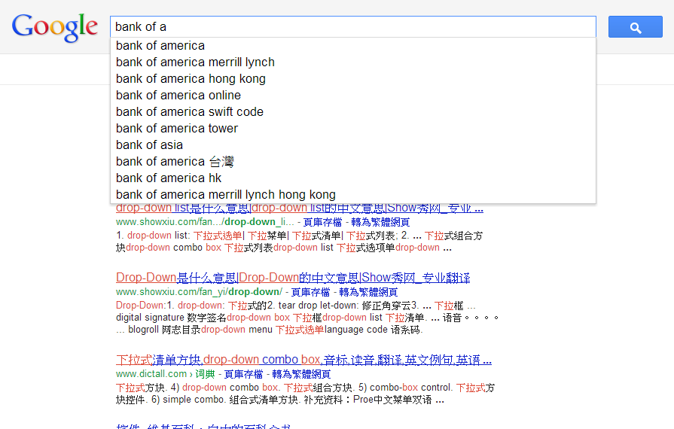
Most Frequent Extensions
20 most frequent queries that contains the original query as a suggestion source, but with one modification; we use a word boundary condition to bring these completions where the query is a full word

Slide 18
Outline
Introduction
Target Generation
Suggestion Candidates
Query logs
Synthetic Suggestions
Most Frequent Extensions
Machine learning
Features
Learning
Evaluation
Conclusions

Slide 19
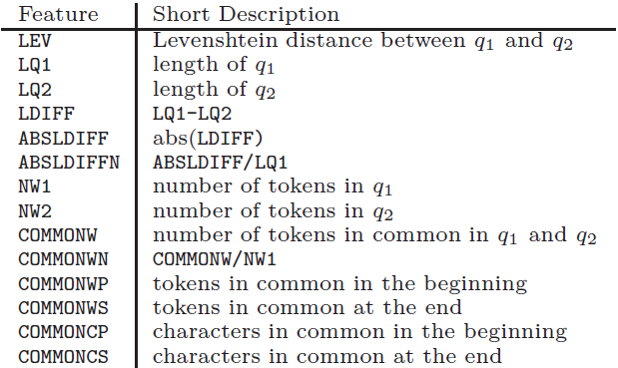
Lexical features

Slide 20
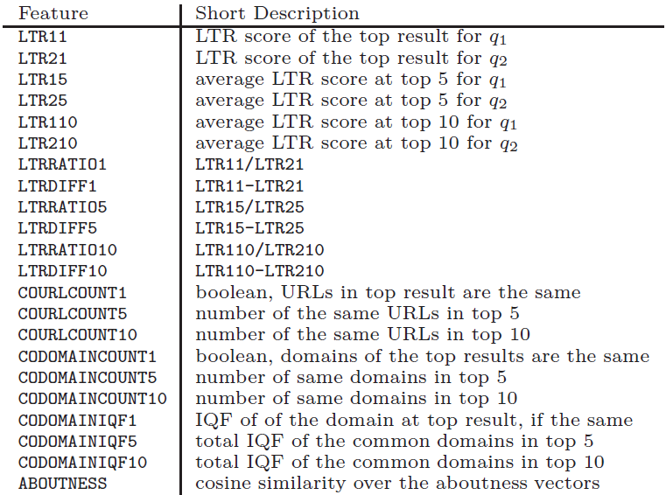
Result set features
quality
overlap

Slide 21
Outline
Introduction
Target Generation
Suggestion Candidates
Query logs
Synthetic Suggestions
Most Frequent Extensions
Machine learning
Features
Learning
Evaluation
Conclusions

Slide 22
GBDT(Gradient Boosted Decision Trees)

Slide 23
Outline
Introduction
Target Generation
Suggestion Candidates
Query logs
Synthetic Suggestions
Most Frequent Extensions
Machine learning
Features
Learning
Evaluation
Conclusions

Slide 24
Evaluation
Query set: random sample of 912 fully anonymized queries issued on a commercial search engine
Manual annotation: a group of eight professional search engine quality evaluators
Annotation guidelines: 4-level ratings (excellent, good, fair, bad)
Variation of the system:
B: baseline , candidates are ranked according to mutual information
10M: ranked by Pr(q2 | q1, u = 1, c = 1); no machine learning model and only the suggestions from the query logs are considered.
10M-ML: ranked by GBDT model; only the suggestions from the query logs are considered.
10M-ML-SY: Same as 10M-ML; synthetic suggestions and most frequent specializations are also considered.
10MC,10MC-ML,10MC-ML-SY: Same as the above three models except that only consecutive pairs in a session.

Slide 25
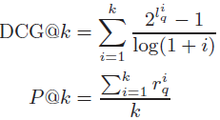
Evaluation
Offline
human judgment
Online
Conducted an A/B test where we tested and compared the
proposed system (10M-ML-SY implementation) against the
baseline on live traffic.
(3 is the best)
=1 when labeled good or excellent
=0 when labeled fair or bad

Slide 26
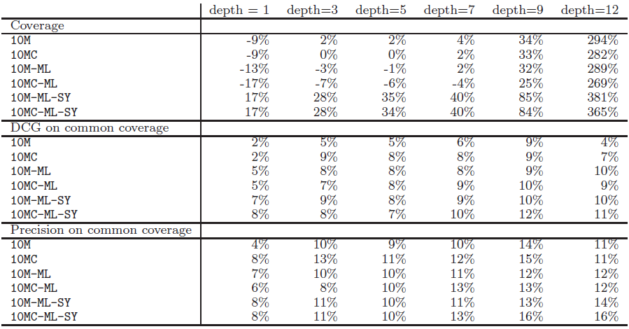
Evaluation
Coverage, DCG, and Precision improvement compared to the baseline:
Coverage: the ratio of the number of queries the system could bring suggestions for to the total number of test queries.
depth = cut-off point

Slide 27
The improvement compared to the baseline in the online test:
CTR (Click-through rate) at k:
$\frac{the number of clicks within the first k suggestions}{the number of result pages with at least k suggestions}$
The system not only increases the chance of finding suggestions for a given query, it also ensures a significantly higher quality of these suggestions.

Slide 28
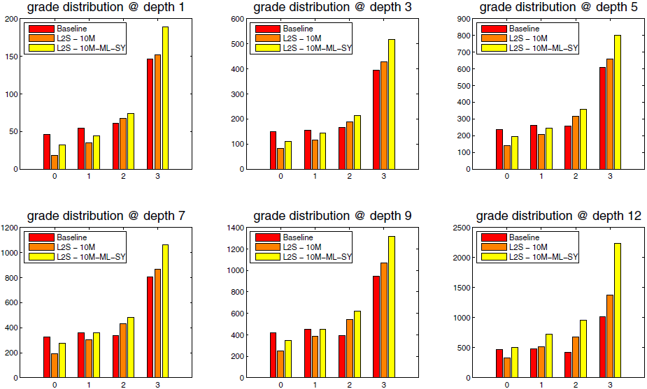
10M and 10MC-ML-SY do perform better
grade distributions are more skewed towards better grades.
the machine learning step has a more important contribution in bringing a lot more good quality suggestions without increasing the ratio of bad suggestions.

Slide 29
Outline
Introduction
Target Generation
Suggestion Candidates
Query logs
Synthetic Suggestions
Most Frequent Extensions
Machine learning
Features
Learning
Evaluation
Conclusions

Slide 30
Conclusions
Present an end-to-end query suggestion method that implements novel ideas such as incorporating usefulness of reformulations, an implicit session boundary model, and a machine learning model to further improve the suggestion relevance and be able to add more sources of suggestions beyond the co-occurrences in query logs.
The click through rates on the online tests are very promising and we plan to extend this work with personalization and further diversification of suggestions.

